Slide 1
CMD Support & Sustaining
CMD Support & Sustaining Team
31st August 2012

Slide 2
Agenda
CMD Support & Sustaining Team
CMD Product Demo
Highlights
CMD Support and Sustaining Statistics
Team Productivity
Achievements
Challenges and Mitigation
Go Live/Upgrade
Customer Feedback

Slide 3


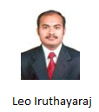
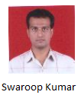
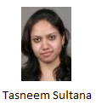
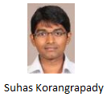
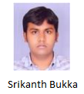
Team Structure
Srinivasa Rao | CMD Support
Swaroop Kumar | CMD Support
Tasneem Sultana | CMD Support
Suhas Korangrapady | CMD Support
Srikanth Bukka | CMD Support
Leo Iruthayaraj | CMD Sustaining

Slide 4
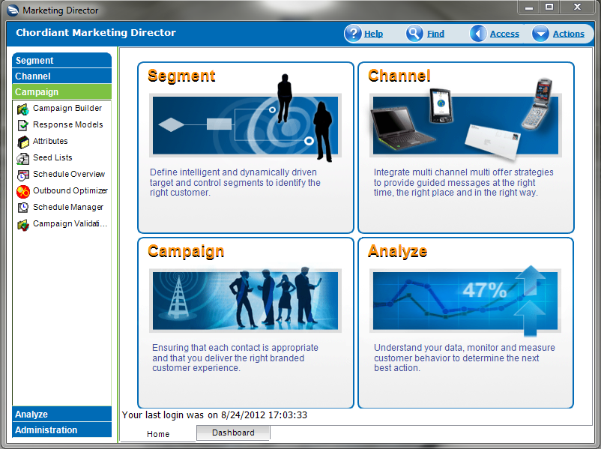
Demo

Slide 5
Highlights
The eldest support and sustaining team.
Work shifts cover 9:00 AM – 12:30 AM (IST) of the following day.
Major Customer stacks/replication environments maintained by support.
Support Release Testing on RC build.
Resolved many issues from development backlog.
Actively participating in development sprint activities.
98 hot-fix’s have been delivered (2009 -12).

Slide 6
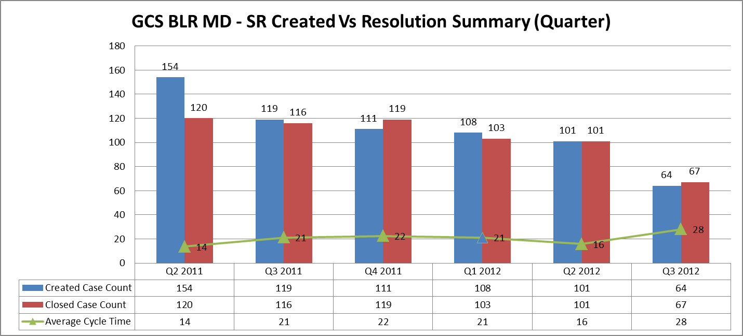
Marketing Director Updates
Recent escalations
T-Mobile US :- Unable to run segments.
BankAsya :- Unable to run segments.
FINANSBANK :- Lock Process is randomly going down.
Banco Popolare :- Campaigns are aborting when segment is used.

Slide 7
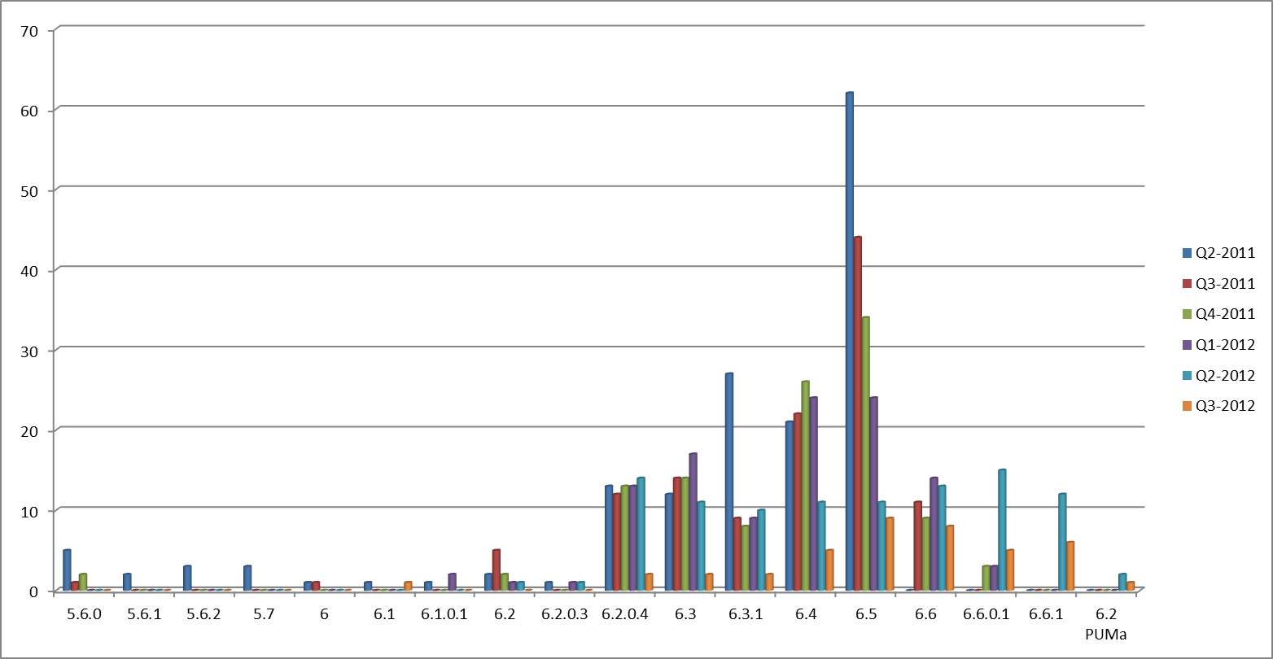
Marketing Director Updates

Slide 8
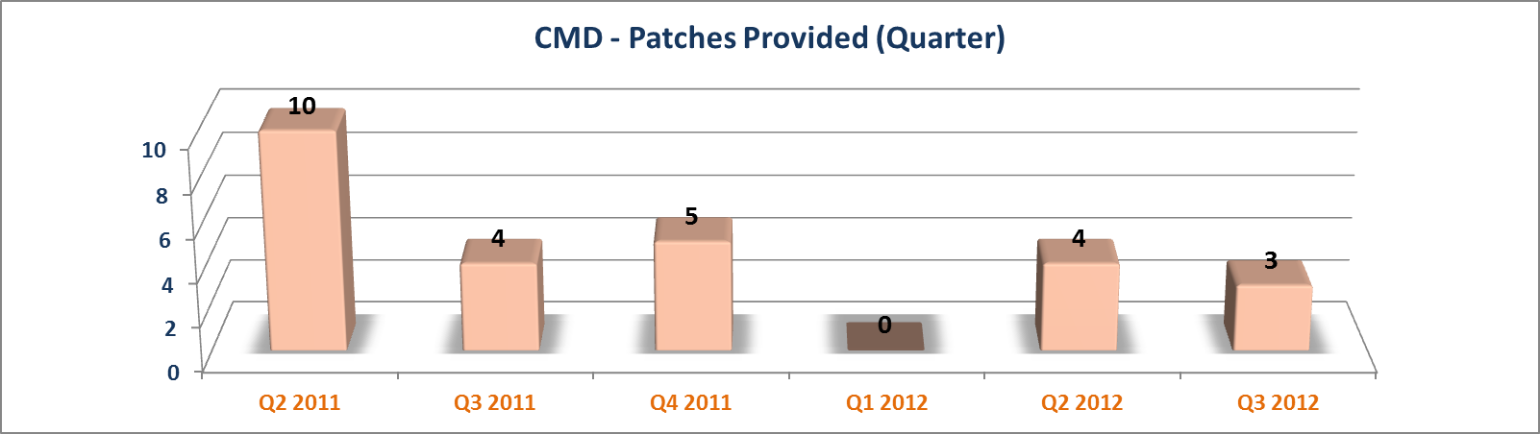
CMD Sustaining Graphs

Slide 9
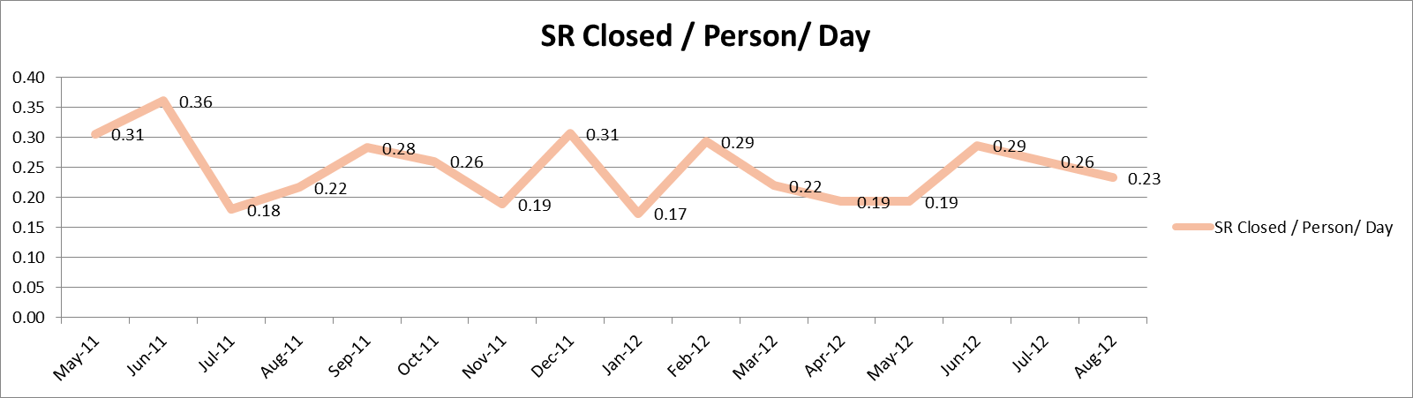
Team Productivity

Slide 10
Achievements
Maintaining very minimal backlog.
Developed CMD Automation architecture and scripts for TVL-0 and TVL-1 test cases. We reduced the QA time as the level of 1:5 ratio.
Assistance provided to CDM team for Office AddIns.
Participating CMD development sprint activities and successfully developing new features.
Resolved MD client compatibility issue on Windows 7.

Slide 11
Challenges / Mitigation
Getting team enabled on Java to handle new email module.
Localization issues (SMS and Email) from Vodafone-India and AKBank.
Identifying OS/DB/Network related issues.
Analysis for Client crashes/hang issues through debug enabled patches.

Slide 12
Go Live / Upgrade
Account Name | Current Version | Migration Version | GoLive/ Upgrade | Remarks
T-Mobile Austria | MD 5.6.x | MD 6.6.0.1 | Jun 2012 | Linux stack
Türkiye Finans Katilim Bankasi A.S |  | MD 6.6 | Feb 2012 | New customer
UPS | MD 6.2.0.2 | MD 6.6.0.1 | Sep 2012 | Linux stack
Haufe Mediengruppe | MD 6.5 | MD 6.6.1 | July 2012
ERA | MD 6.5 | MD 6.6.1 | Q4 - 2012 | Upgraded TEST environment in July
Principal Financial Group | MD 6.3.1 | MD 6.6.1 |  | S/W CD has been delivered on July last week.
Cell-C | MD 6.2.x | MD 6.6.1/Linux |  | Planned to upgrade in June but no further information
BIMA | MD 6.5 | MD 6.6.1 | August 2012 | Partner

Slide 13
Customer Feedback
UPS
I am able to run Campaigns also Segments in batch mode now. Thank you for providing details on time.
T-Mobile UK
we are happy with the response, thank you for the prompt response this is very good detailed answer.
T-Mobile Austria
I tested this on development first. Maybe the proc should be extended with a check if the table still exists before dropping as I have seen in another purge procedure. In any case I am very happy with the progress.
LBP
We faced a problem when trying to open campaigns as every time we tried, we got a client shutdown. We did not have time to investigate further but the good news is that, at least, the connection issue is over. We’ll see to open a new case in the coming days for this new issue.
Great dealing with you again. ☺ Thank you so very much for your quick response. Thanks a million and I will get back to you as soon as I can.
Cell - C
Thanks a lot to everybody for your help. This was not an easy issue and you managed to find a solution. Well done!

Slide 14
Thank You

Slide 15
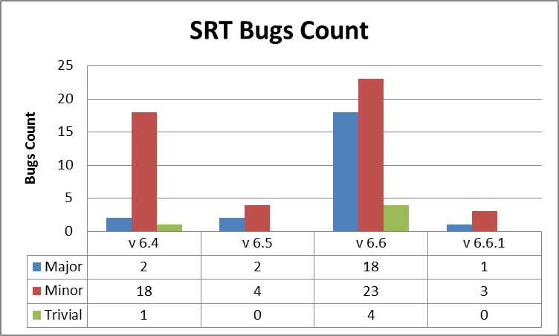
SRT Bugs

